Slide 1
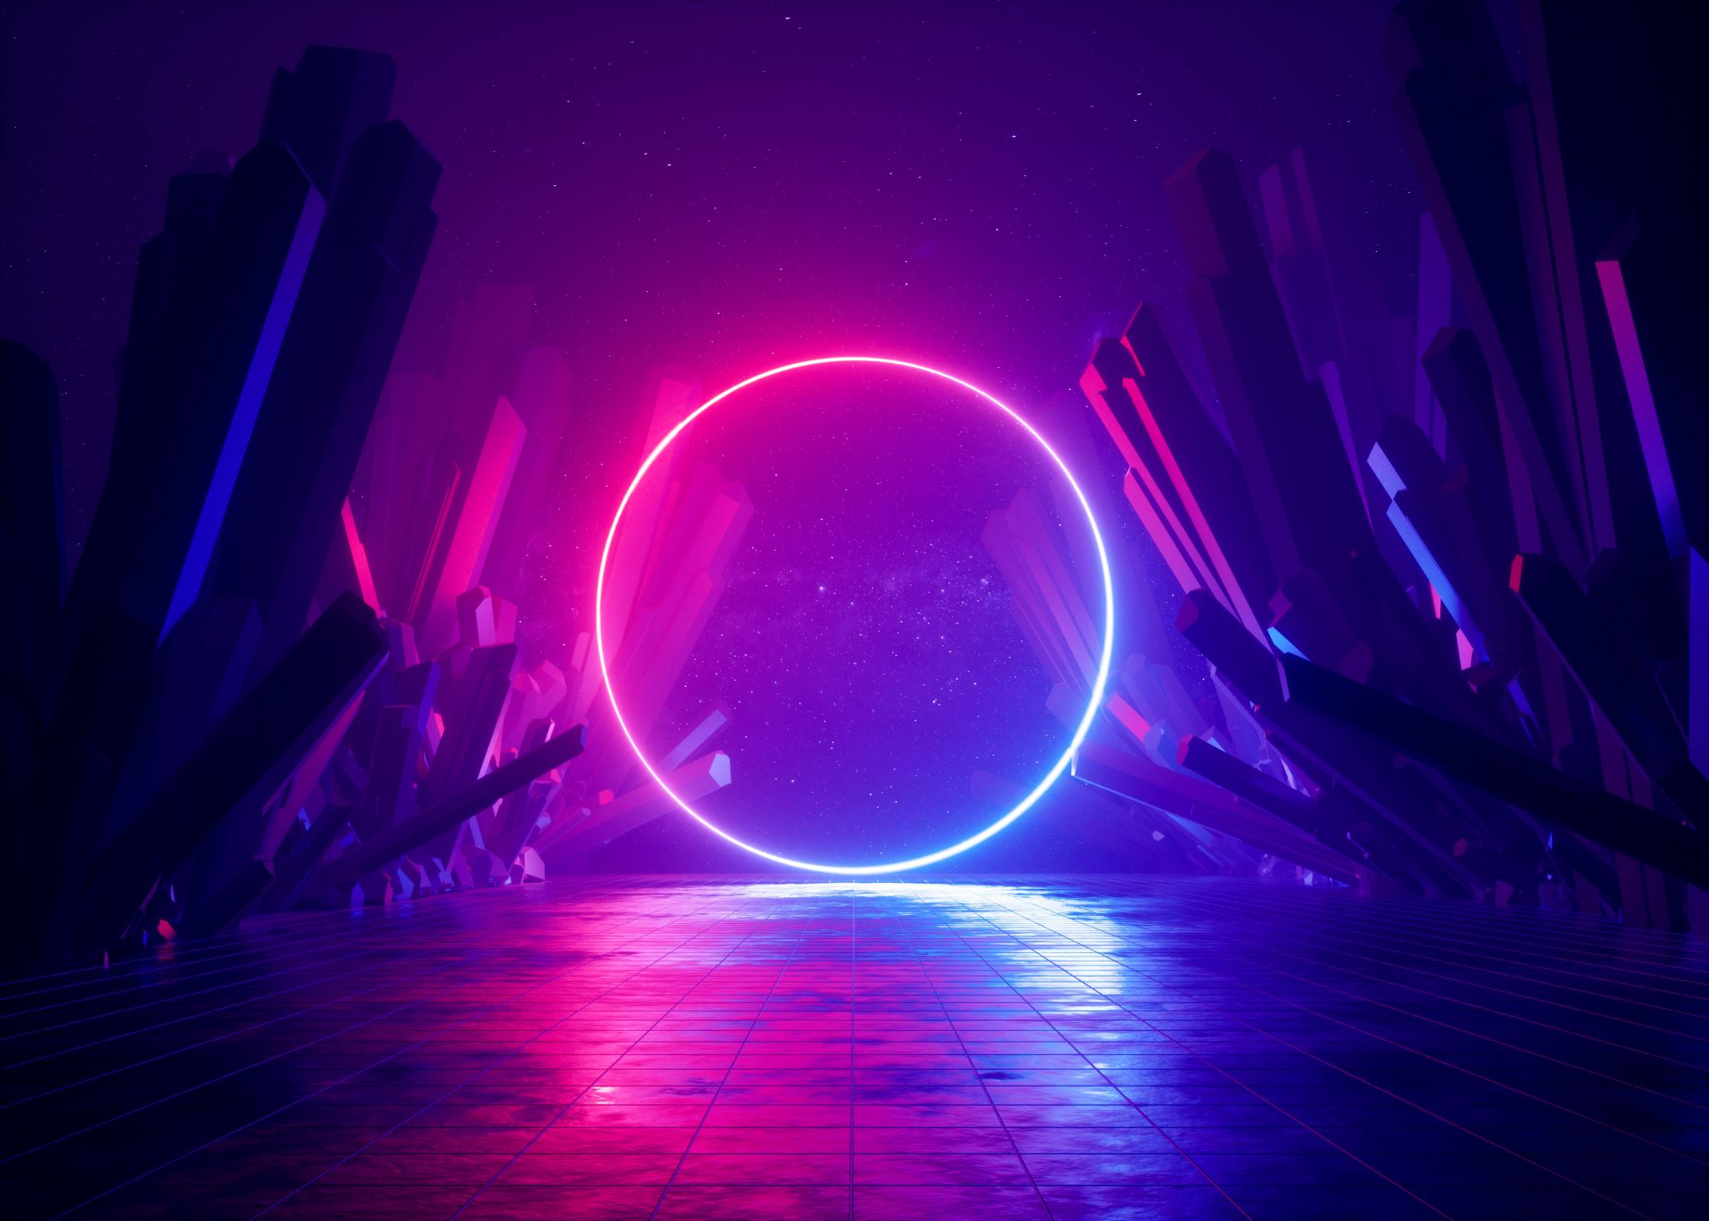
MERN Full Stack
Akshay J Sharma
B.Tech CSE
BPEM0569

Slide 2
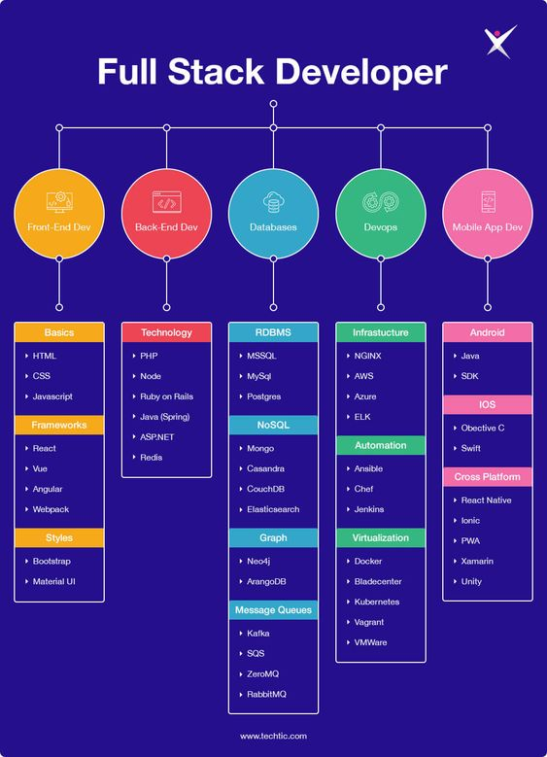
Full stack development is the end-to-end development of applications. It includes both the front end and back end of an application. The front end is usually accessed by a client, and the back end forms the core of the application where all the business logic is applied.

Slide 3
Popular Stacks
MEAN Stack: MongoDB, Express, AngularJS and Node.js.
MERN Stack: MongoDB, Express, ReactJS and Node.js.
JAVA Stack: JDBC, SpringBoot, Java.
Django Stack: Django, python and MySQL as Database.
Rails or Ruby on Rails: Uses Ruby, PHP and MySQL.
LAMP Stack: Linux, Apache, MySQL and PHP.

Slide 4
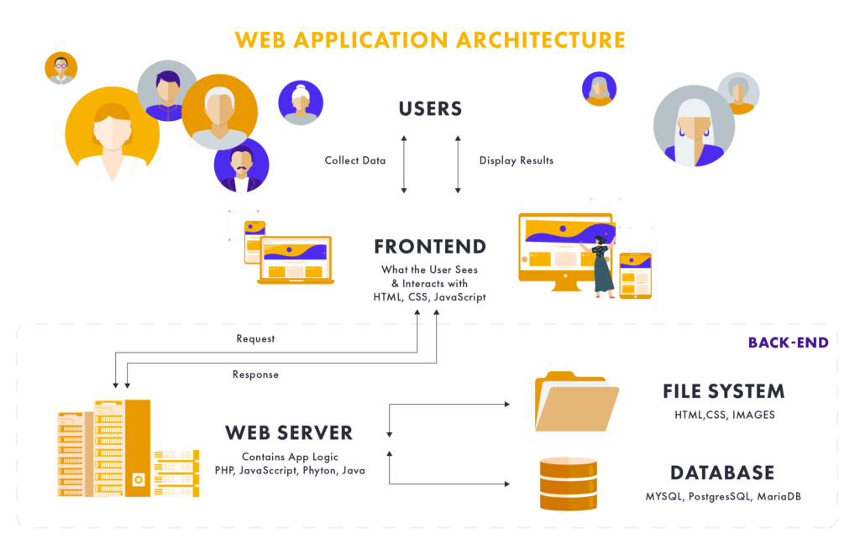
Technologies in Full Stack

Slide 5
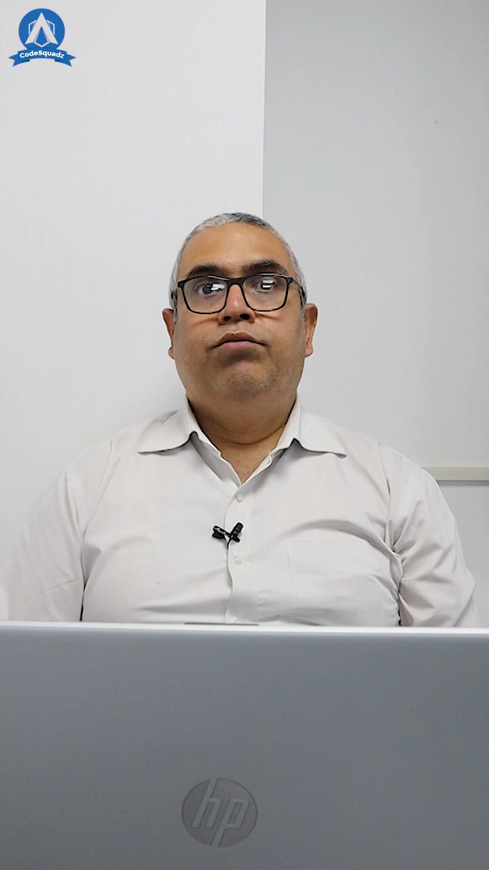
MERN Full Stack

Slide 6
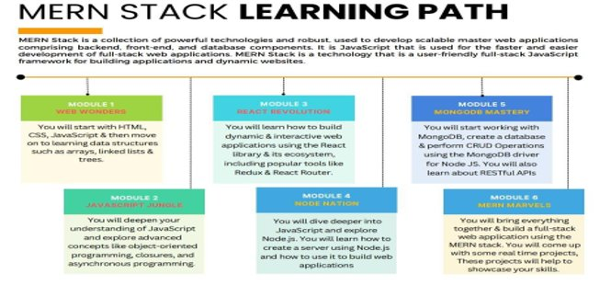
Why did I opt MERN Full Stack ? What is MERN Full Stack ?

Slide 7
Topics covered till date
Introduction - Course outcomes
Git - local repository, CURD operations in git bash.
Github – global repository, push and pull commands, urls.
HTML – Formatting tags, form, table.
HTML5 – Multimedia, advance version.
CSS Basics – Selectors(5 types), Combinations(4 types).

Slide 8
Topics yet to be completed
CSS Box Model
CSS Advance
CSS3
Bootstrap
JavaScript
React js
Express js
Node js
Mongodb

Slide 9
How's your preparation going on?
Practice.
Prepare.
Pushing to github from git.
Trying to implement it in real world project.

Slide 10

Thankyou

